Slide 1



Waterfall Model
Advantages and Disadvantages
Presented by
21102B0010
TE CMPN-B
Pradip Garhwal

Slide 2

What is Waterfall Model?
The Waterfall Model is a traditional and linear software development methodology that divides the software development process into distinct phases. Each phase must be completed before moving on to the next, and there is typically no going back to a previous phase once it's finished

Slide 3
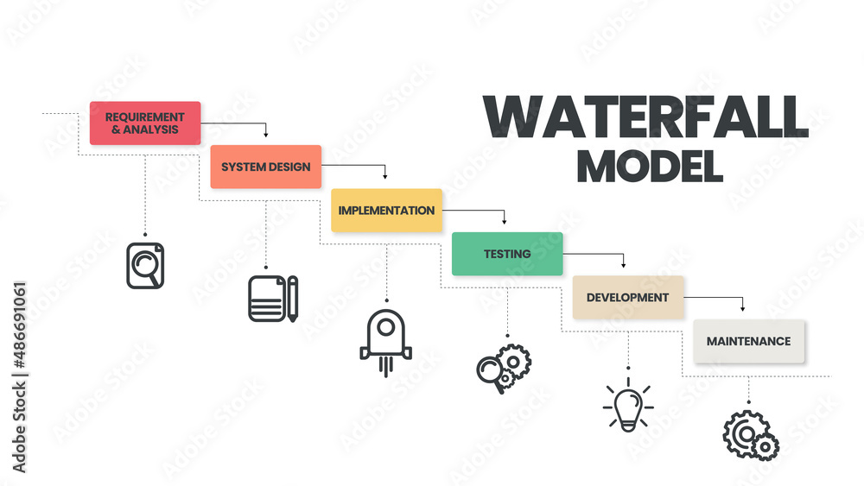
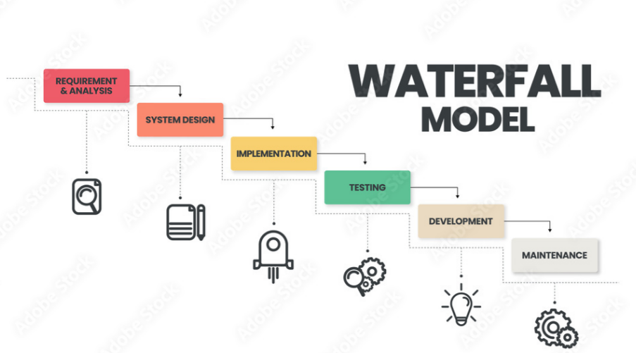

Slide 4


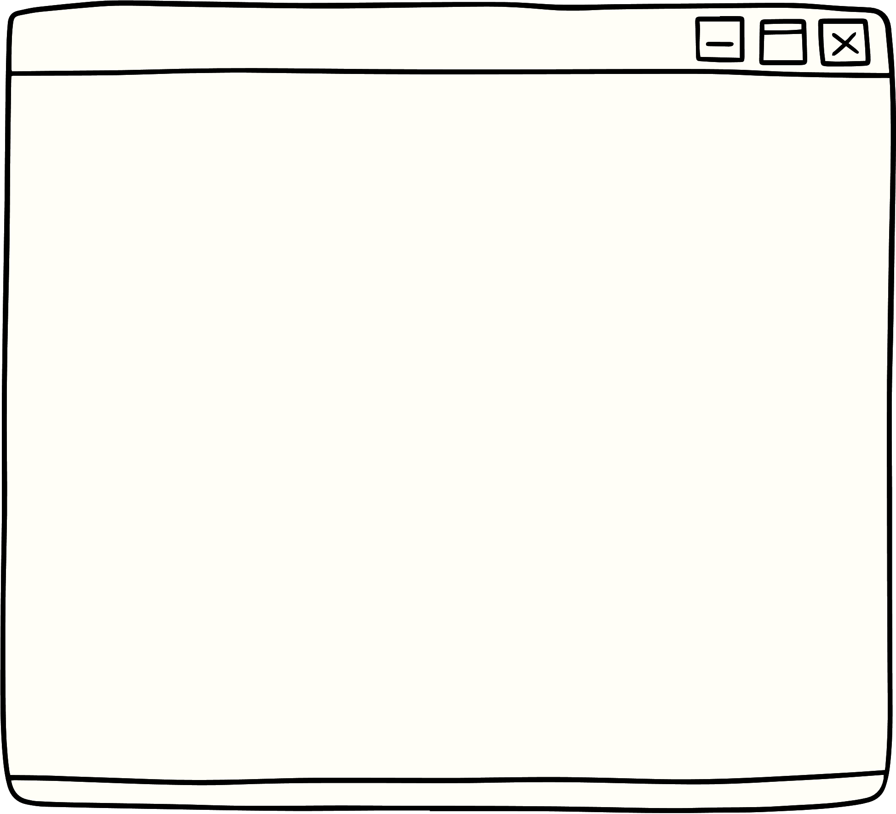



Requirement Analaysis
In this phase, project stakeholders, including customers and end-users, collaborate with the development team to define the project's requirements. The goal is to gather a comprehensive understanding of what the software or product should do.

Slide 5
System Design
Once the requirements are gathered, the system design phase involves creating a high-level architecture and design for the entire system. This includes defining data structures, software architecture, and the overall system structure.

Slide 6
Implementation
In this phase, developers start coding based on the design specifications. They write the actual code for the software, following the coding standards and guidelines established during the design phase.

Slide 7
Testing
After coding, the software goes through various testing phases. This includes unit testing (testing individual components), integration testing (testing how different components work together), and system testing (evaluating the entire system's functionality).

Slide 8
Deployment
Once the software has been thoroughly tested and meets all the requirements, it is deployed to a production environment or delivered to the customer.

Slide 9
Maintenance and Support
: After deployment, the software requires ongoing maintenance and support. This phase involves addressing any issues that arise in the live environment, making updates or enhancements, and ensuring the software continues to function as expected.

Slide 10
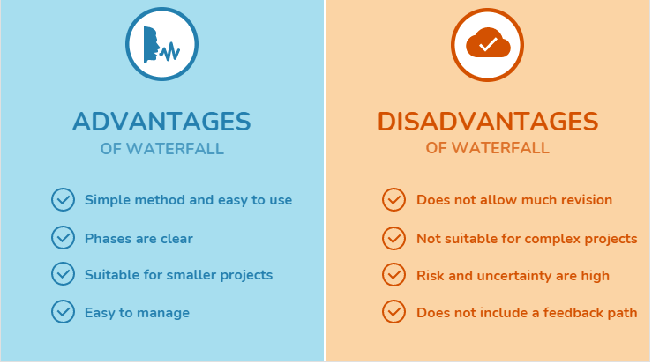

Slide 11


Pradip Garhwal
21102B0010
Thank you!
Have a great day ahead.

